Slide 1
Monitoring
Being Better than Indy

Slide 2
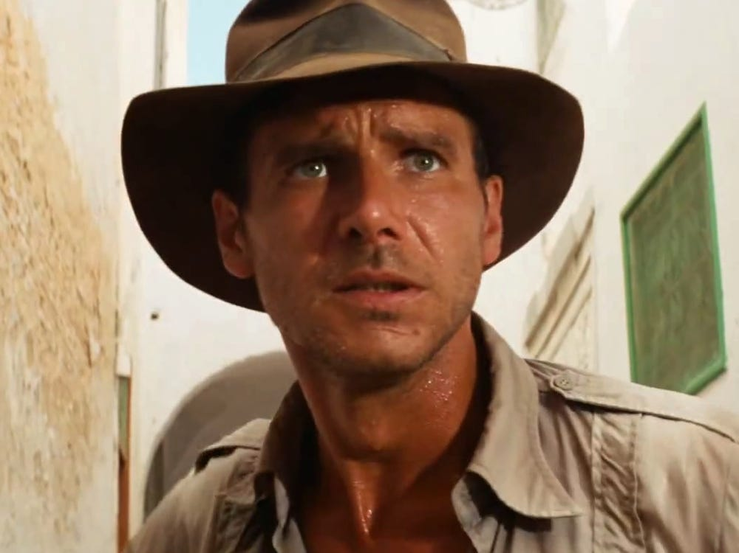
Project Brief: Basics
Project Name | Happy Fish
Project Purpose | Replacing a derelict culvert to a fish-friendly culvert.
Project Proponent | Fishopolis Department of Transportation
Federal Agency | Federal Transit Administration (FTA)
ESA’s client | Mr. and Mrs. Flippers-Fin
Monitoring Plan | Keep copy with you (digital is OK)
Project Safety Plan | Review prior to arriving on construction site.
Day Shift | Typically 7:30am – 3:30 pm (VARIES by construction activity)
Night Shift | Typically 8:30pm – 2:00am (VARIES by construction activity)
Location | Fishopolis, along the west side of the stream between 1st and 2nd Ave E
Parking | Street or parking garage. Parking should be expensed to the project
Collector App Info

Slide 3
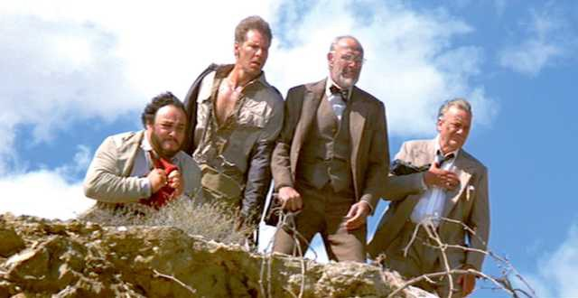
Project Brief: Contacts
ESA Project Manager | Name, email, phone (cell)
ESA Field Lead | Name, email, phone (cell)
FDOT Inspector | Name, email, phone (cell)

Slide 4
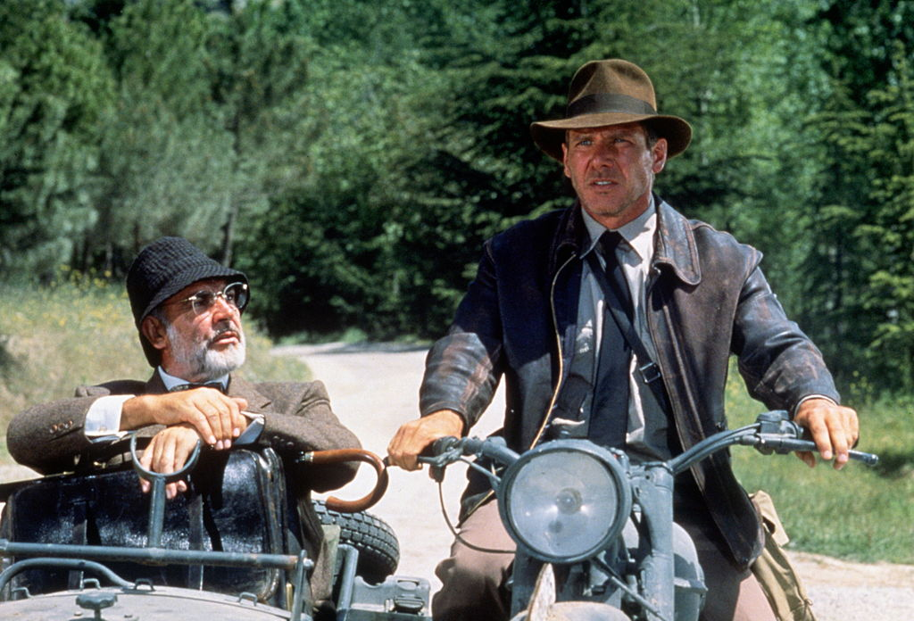
Project Brief: Schedule, Parking, IT
Day Shift | Typically 7:30am – 3:30 pm (VARIES by construction activity)
Night Shift | Typically 8:30pm – 2:00am (VARIES by construction activity)
Location | Fishopolis, along the west side of the stream between 1st and 2nd Ave E
Parking | Street or parking garage. Parking should be expensed to the project
IT App Info

Slide 5
Project Brief: Monitoring Approach Summary
On-Site | <insert description>
On-Call | <insert description>
Precontact Isolates | <insert description>
Historic Isolates | <insert description>
Historic Areaways | <insert description>

Slide 6
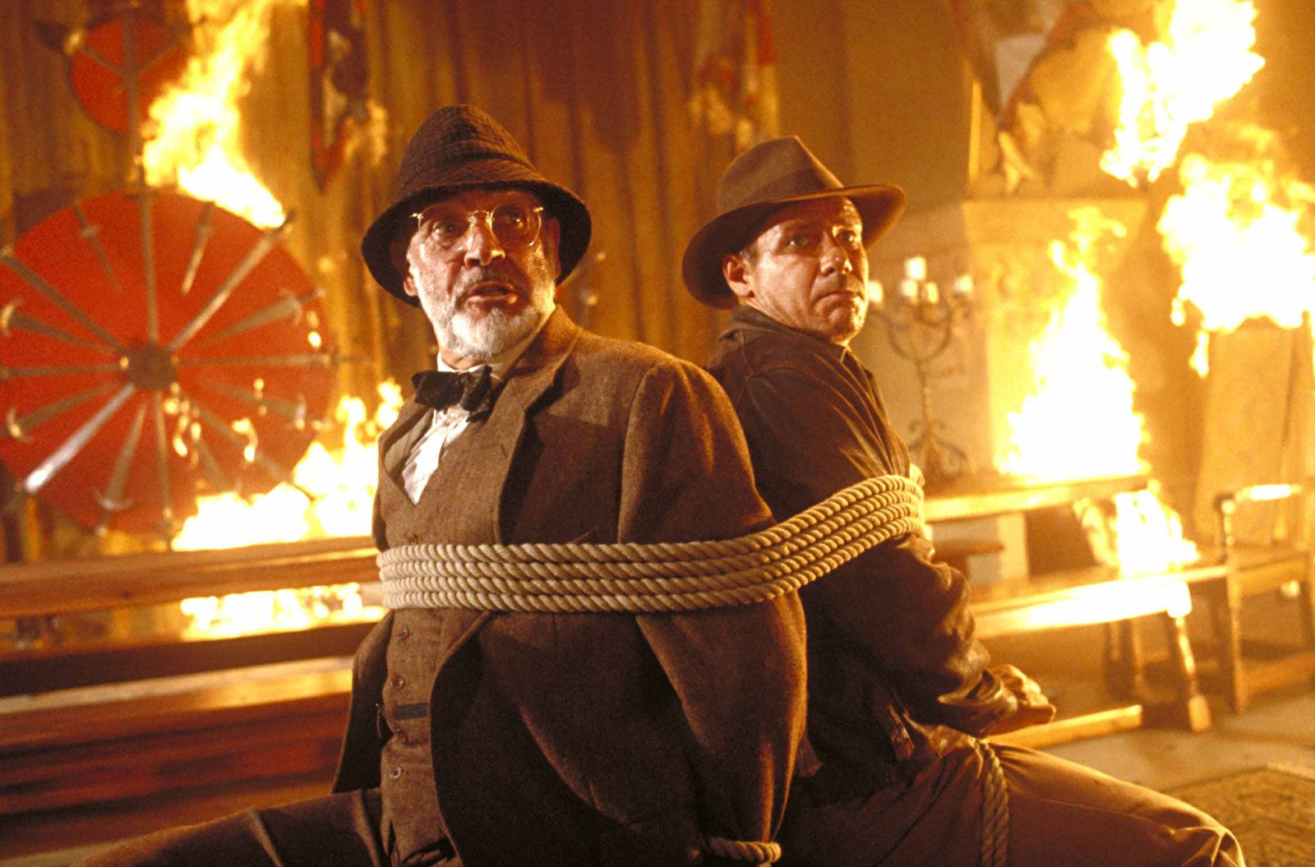
Project Brief: Billing
Project number | <insert description>
Task | <insert description>, Subtask <insert description>
Paid Miles | <insert description>
Paid Drive Time | 1 hour round trip
Paid Parking | Expense with photo of your parking receipt
Tolls | Cannot be expensed

Slide 7
PPE: WHAT ARE YOU WEARING?!
Hard hat and ear protection
Backpack with water, snacks, and personal first aid kit
Hi-Viz Vest and long sleeves (optional UV gloves)
Rugged pants and optional gaiters
Steel or Safety-Toe Boots

Slide 8
PPE Accessories: For your comfort
Sunscreen
Eye Protection
Change of socks
Multiple layers accessible
Hardhat, neck gaiter, face covering
Gloves (for warmth or UV protection)
Hand heaters / cool packs
Food and water/electrolytes

Slide 9
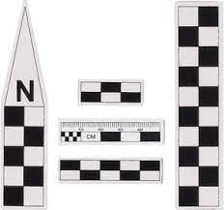
PPE Accessories: for your work
Hard copy of your Monitoring Plan
Project Brief/cheat sheet, including a list of contacts and their info
Artifact bags (multiple sizes)
Photo scale
Meter stick or measuring tape
Rite-in the-rain notebook
Sharpe, pencil, pen (multiple)
Spare battery pack and necessary cords

Slide 10
HOW TO:
Be on time (a.k.a. early)
Park somewhere safe
Know who you’re supposed to check in with and do it.
Both your project manager and your site manager.
Ask what the tasks are for the day (if you need a refresher)
Ask where would be a safe place to stand.
ALWAYS make eye contact with the operator before you cross in the path of the earthmoving equipment.
Keep your HAZWOPER training up to date.
During the course of the excavation, if you identify something that needs to be inspected, communicate that with your team before investigating it further because the excavation will need to be halted for everyone’s safety.
Follow the protocol in your monitoring plan for reporting purposes.
At the end of every day, report to your company project manager so that everyone knows that you are safe.
If you have any questions please reach out! My contact info is on the Summit resources page. (bibliography no biography)

